Slide 1
An Analysis on Cryptocurrencies
Kevin Z & Marc S

Slide 2
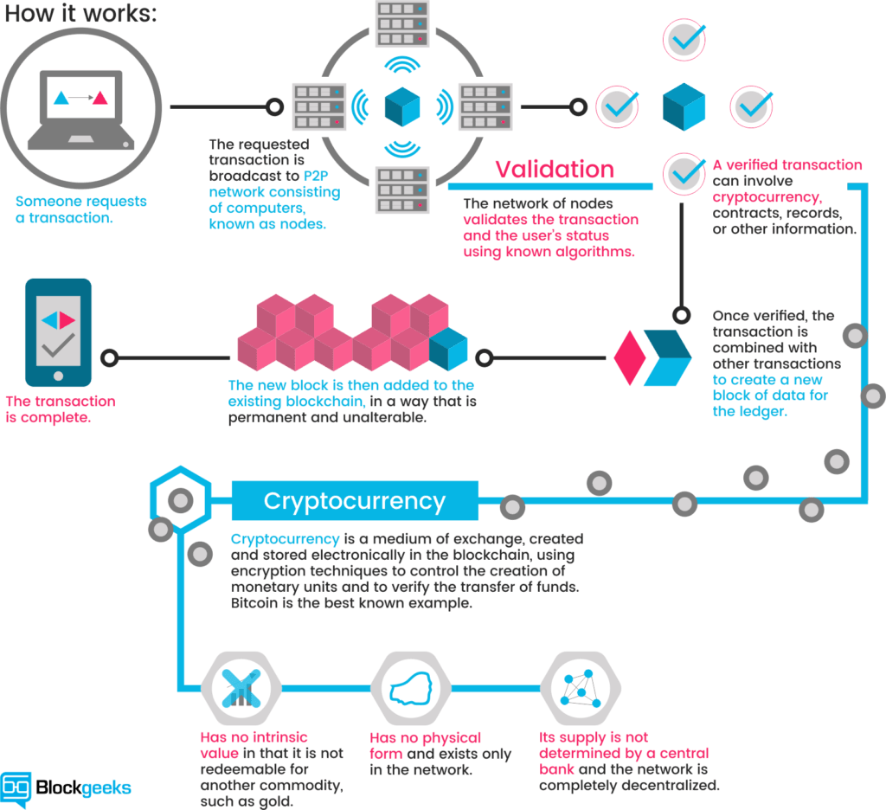
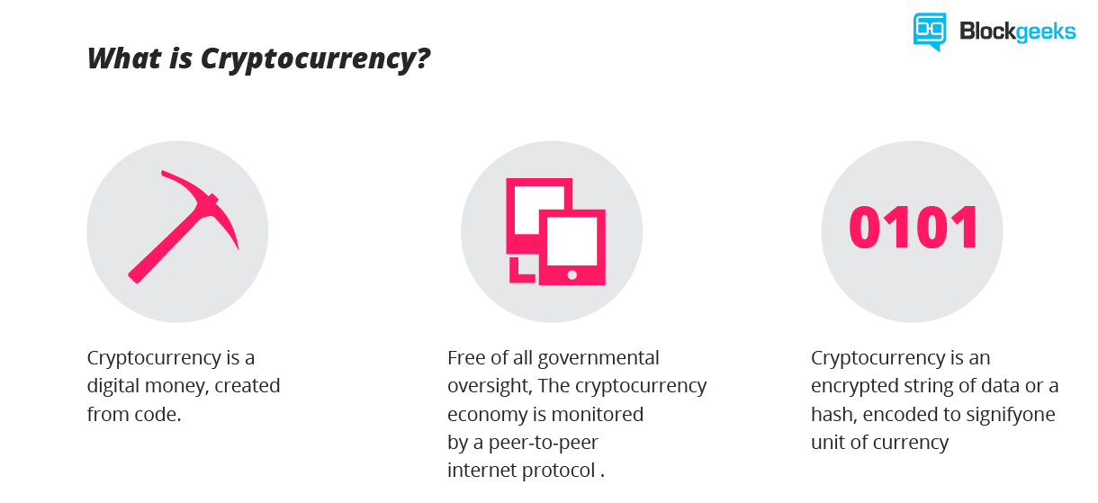
What are cryptocurrencies?
A discussion about cyptocurrencies would be incomplete without an introduction to blockchain technology.
Bitcoin (BTC) Rank#1:
Most well known
≈ $60B market value

Slide 3
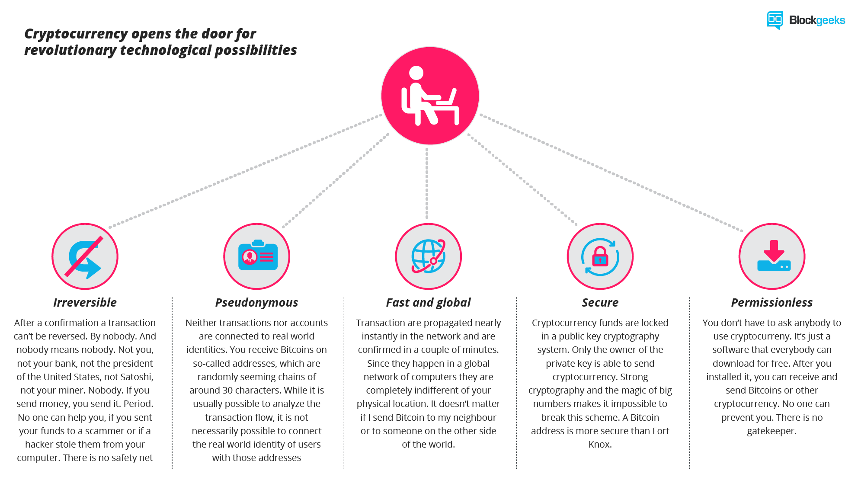
Why are cryptocurrencies important?

Slide 4
Coins Studied in Our Analysis:
Top 3 | Top Quartile | Median | Bottom Quartile | Bottom 3
Bitcoin: BTC | Dogecoin: DOGE | Verge: XVG | Loopring: LRC | Elastos: ELA
Ethereum: ETH | Vechain: VET | Aeternity: AE | Aurora: AOA | Kucoin: KSC
Ripple: XRP | True USD: TUSD | Stratis: STRAT | Quant: QNT | Wanchain: WAN
From the 100 Top Cryptocurrencies by Market Capitalization
Source: Coinmarketcap.com

Slide 5
Descriptions of Some Cyptocurrencies in our Analysis:
Subgroup | Description
Subgroup Top 3: Ethereum (ETH) Rank#2 Market Capizalization ≈ $13B | Ethereum is the pioneer for blockchain based smart contracts. When running on the blockchain a smart contract becomes like a self-operating computer program that automatically executes when specific conditions are met.
Subgroup 1st quartile: Dogecoin (DOGE) Rank#24 Market Cap ≈ $225M | Based on the popular "Doge" Internet meme and featuring a Shiba Inu on its logo, Dogecoin (DOGE) is a cryptocurrency that was forked from Litecoin in Dec 2013. Dogecoin has been used primarily as a tipping system on Reddit and Twitter to reward the creation or sharing of quality content.
Subgroup 2nd quartile: Verge (XVG) Rank#49 Market Cap ≈ $90M | Created in 2014 under its original name of DogecoinDark, Verge (XVG) is an open-source privacy coin with a team of international developers. Verge uses the anonymity tool Tor and an anonymous network layer I2P to hide specific transactions’ IP addresses and locations.
Subgroup 3rd quartile: Quant (QNT) Rank#76 Market Cap ≈ $42M | A cryptocurrency token and operates on the the Ethereum platform. Quant has a current supply of 14,612,493 QNT with 9,777,236 QNT in circulation
Subgroup Bottom3 : Wanchain (WAN) Rank#99 Market Cap ≈ $30M | Key features are cross-chain interoperability, privacy, and smart contract functionality. Wanchain connects and facilitates the transfer of value between different blockchains in a distributed fashion

Slide 6
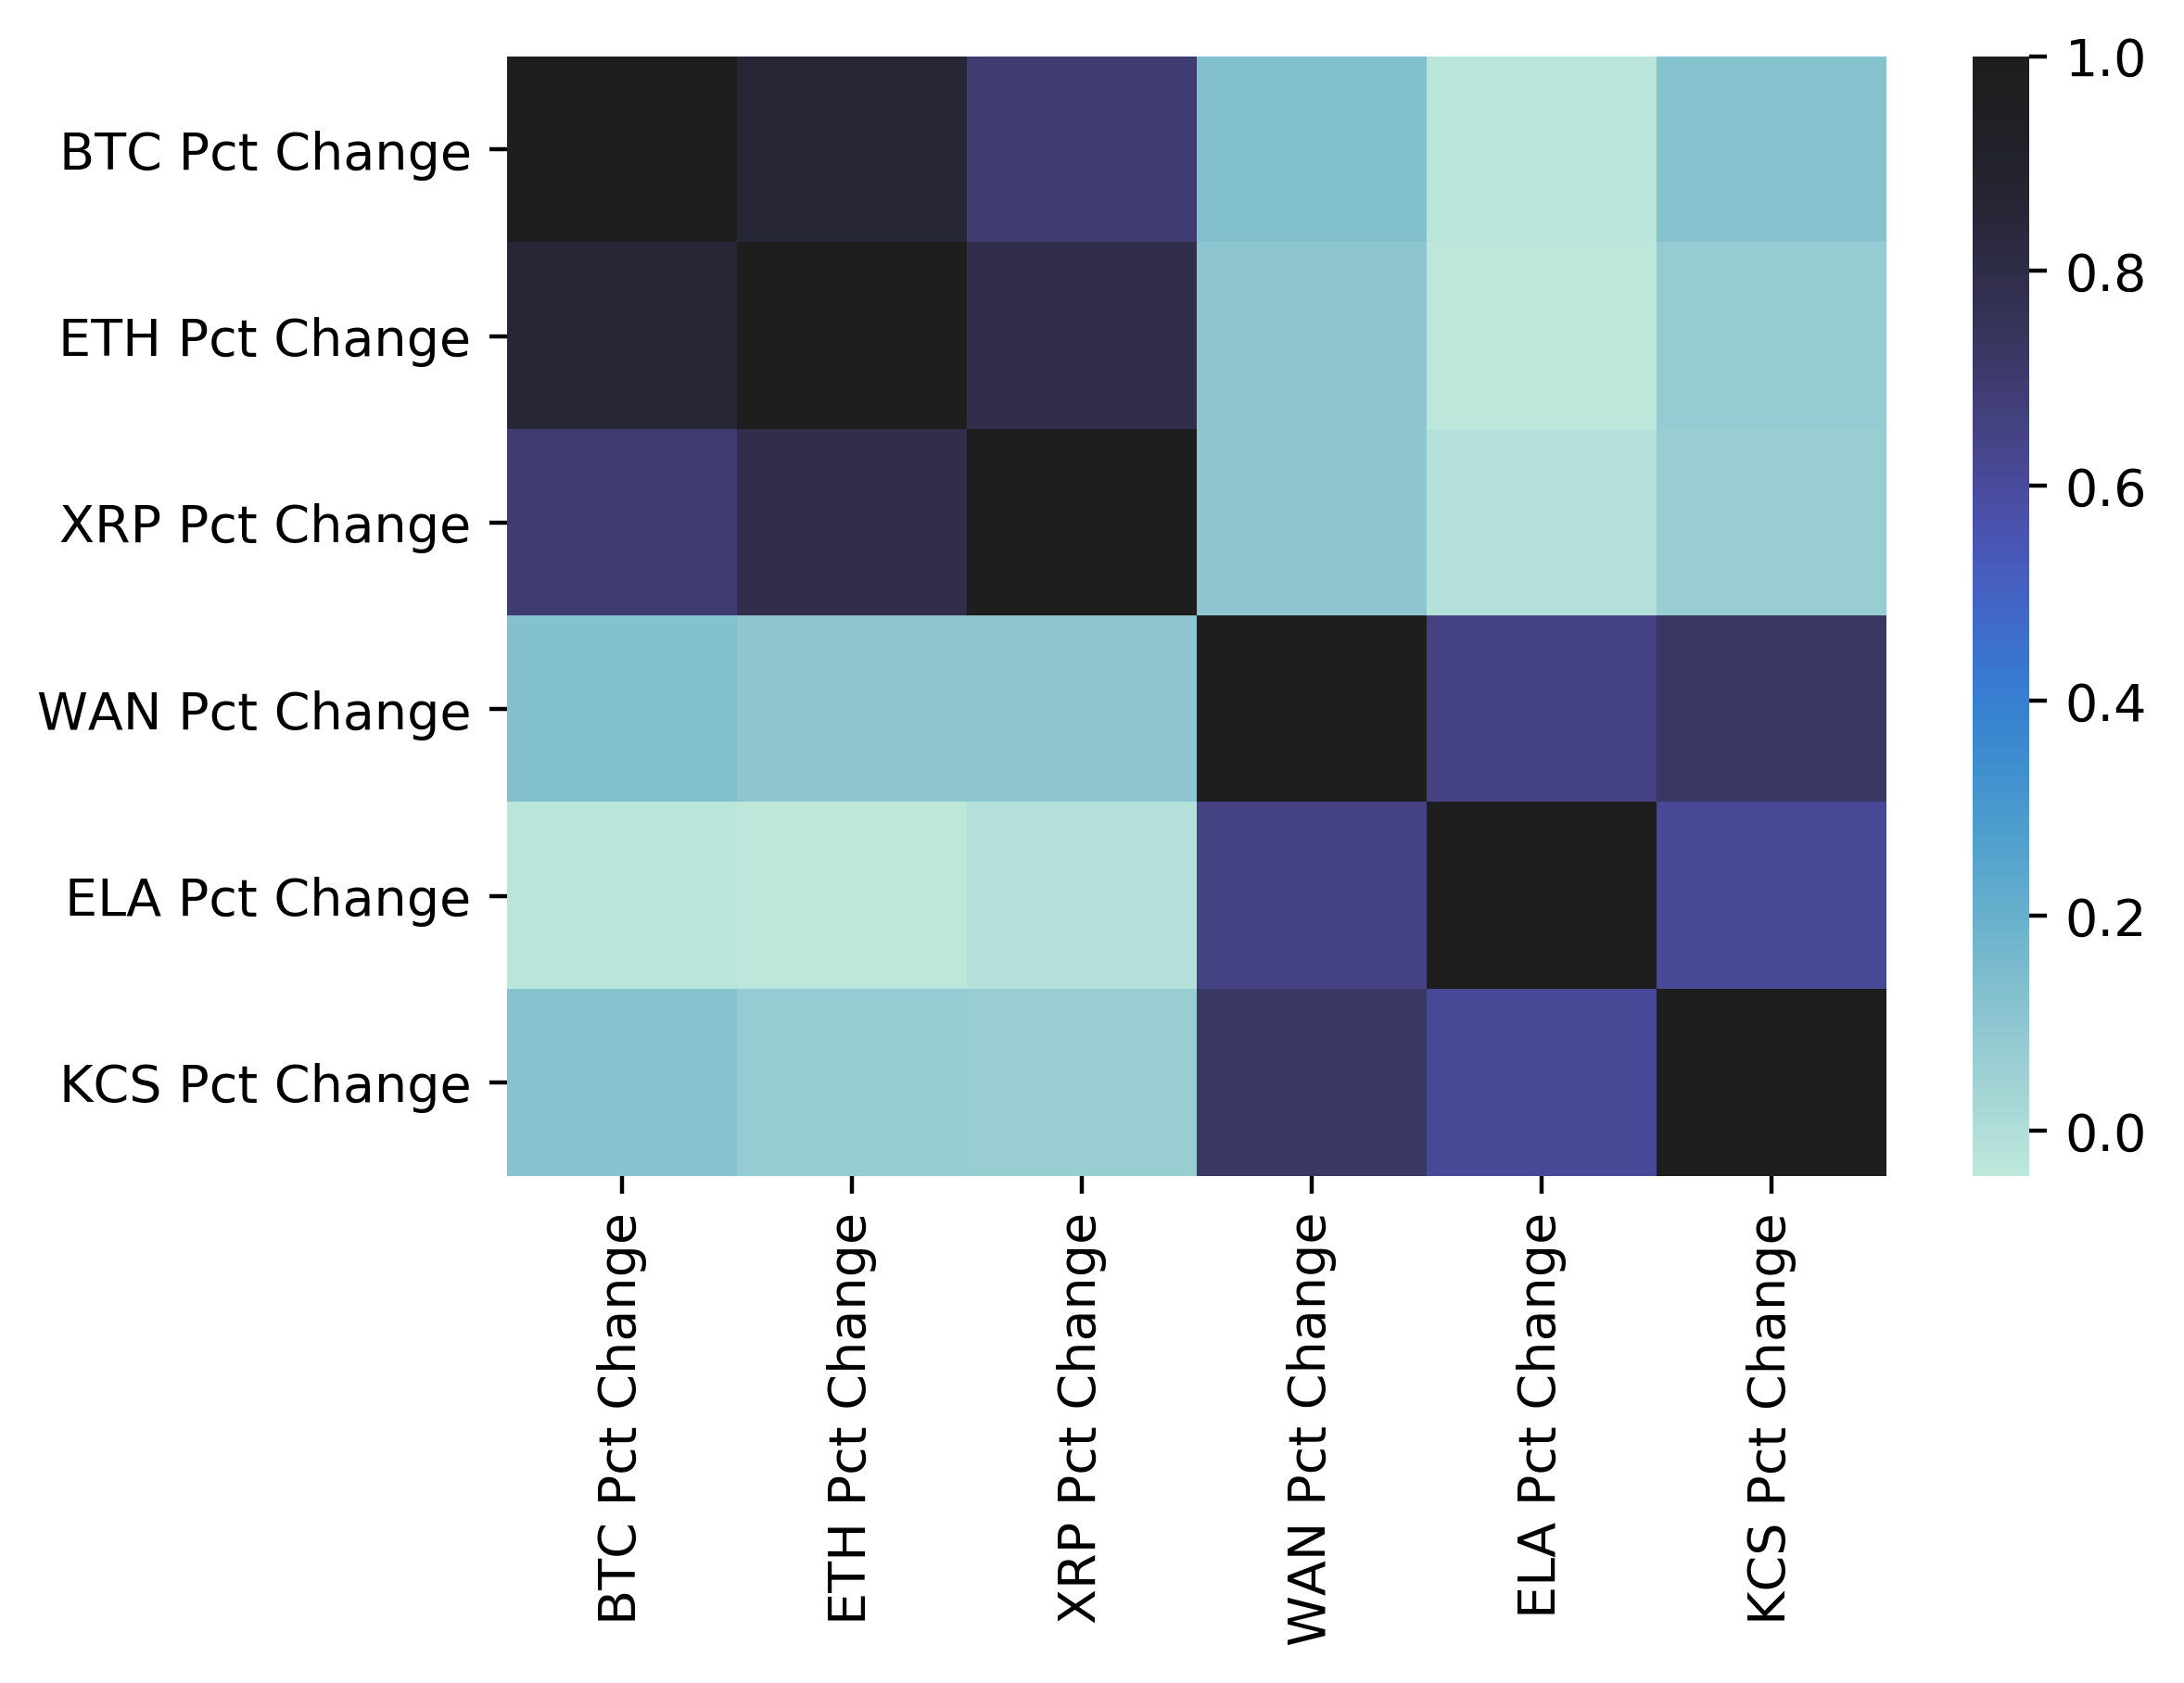
Our Initial Experiment
Initial thought: what effect does top cryptocurrencies have on lower half
Ran correlation analysis on top 3 and bottom 3
Discovered top 3 and bottom 3 only correlated within their groups
Surprised to find no influence of top 3 on bottom 3
Notes:
Wanted to see if there is a correlation and how strong of a correlation there was among the top 3 and bottom 3 cryptocurrencies of the top 100 cryptocurrencies by market capitalization.
What we found running a correlation analysis on day over day percentage changes of the top 3 and bottom 3 currencies in the top 100 cryptocurrencies by market cap was that the top 3 cryptocurrencies tended to trade in the same direction with each other, and the bottom 3 tended to trade in the same direction with each other. Surprisingly, there was little to no influence between the groups.

Slide 7
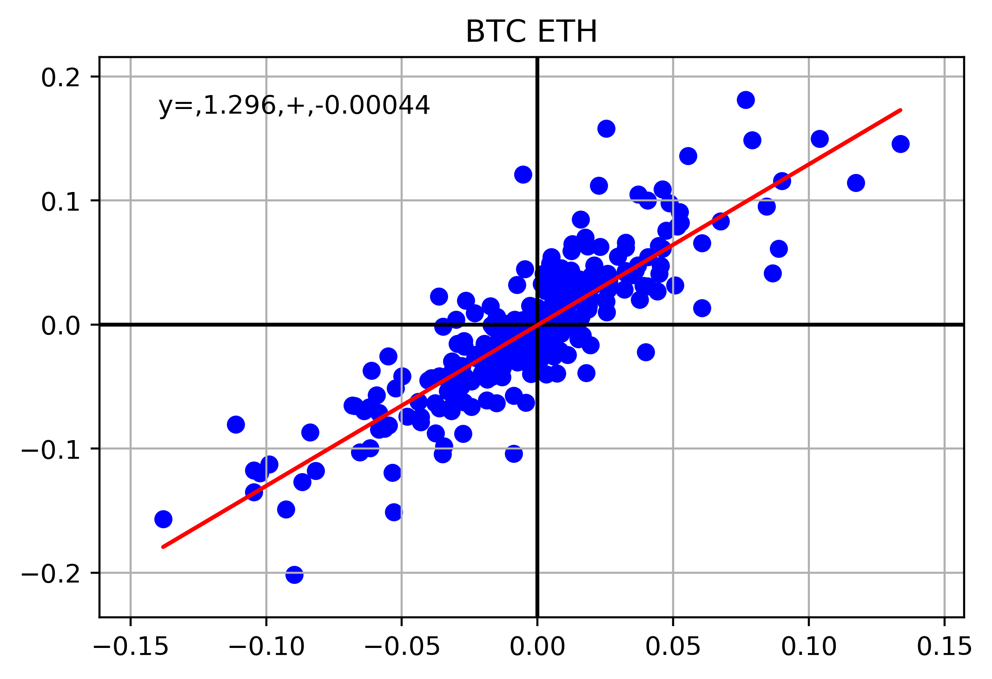
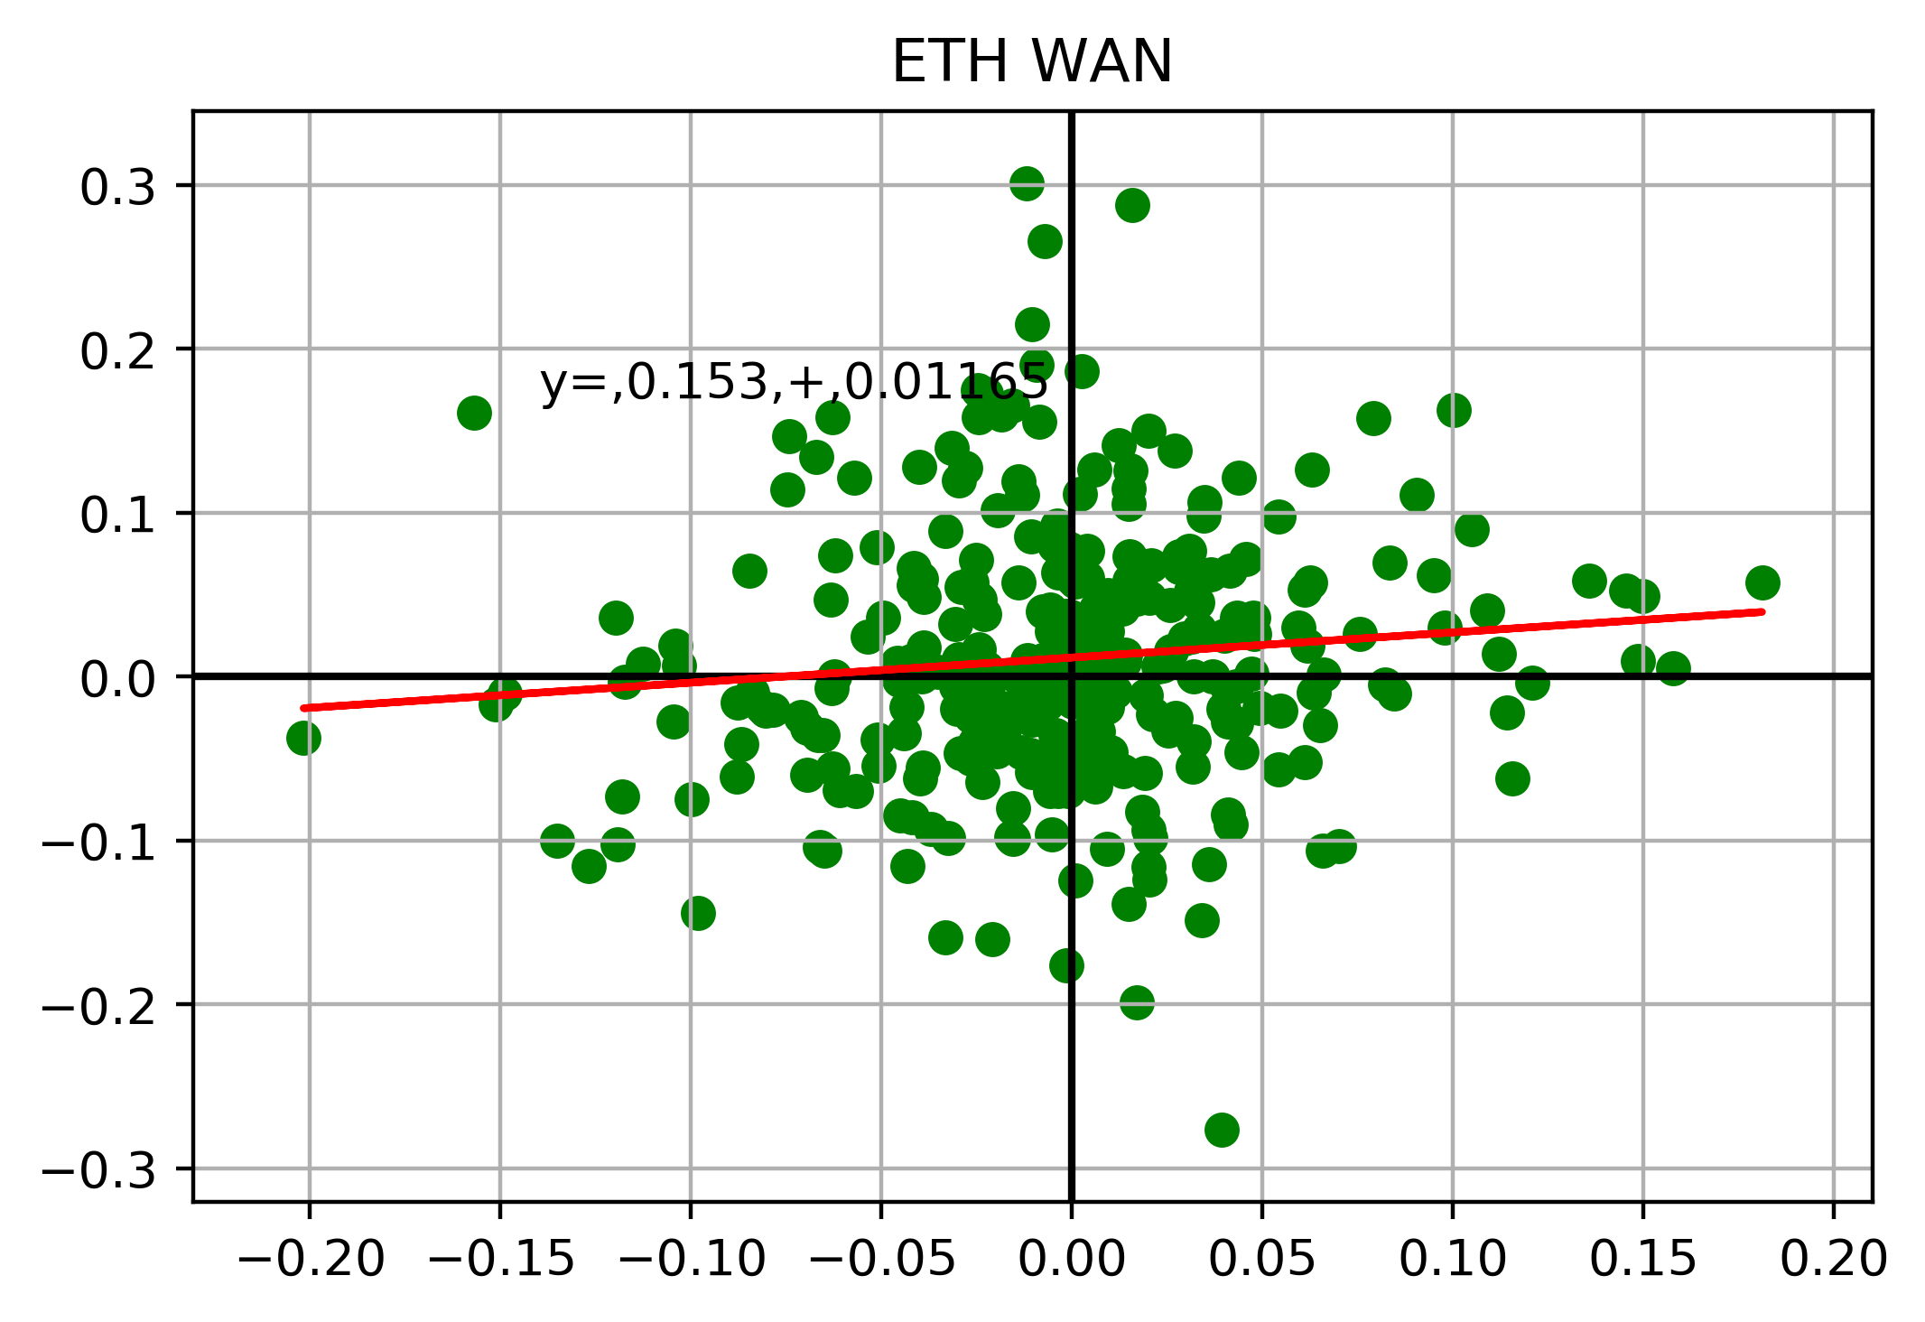
Scatterplot: Top 3 and Bottom 3
Two of the Top 3: Bitcoin and Ethereum.
One Top 3 crypto and one bottom 3 crypto: Ethereum and Wanchain.

Slide 8
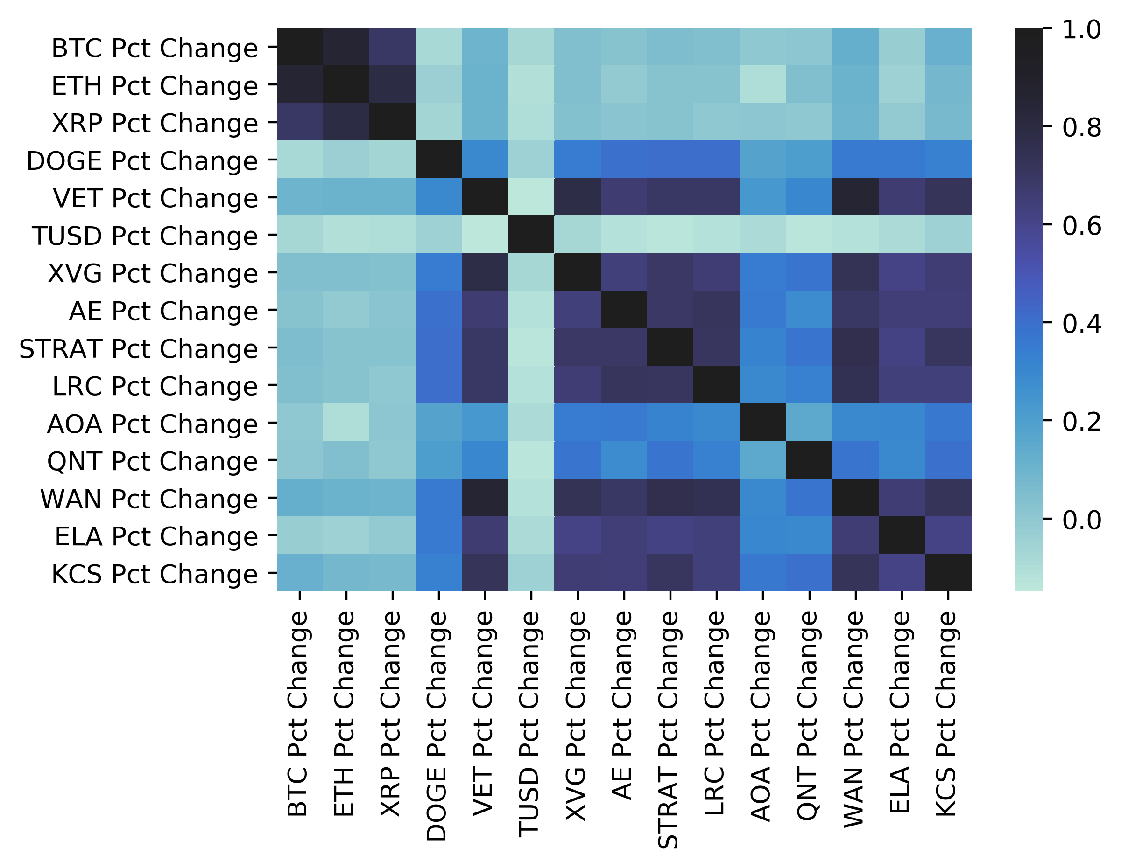
Diving Deeper:
Having discovered that the heavyweight cryptocurrencies did not have an influence on the performance of the smallest cryptocurrencies in our list. We wanted to test other sample sets within our the top 100.
5 Subgroups:
  Top 3, 3 from each of 1st , 2nd and 3rd quartile, bottom 3
Top 3 seems to have an exclusive group of trading direction
Middle quartile traded in same direction as their group and the bottom cryptos
Second and third quartiles had less correlation with others
Notes:
We created a totally of 5 subgroups: The top 3 cryptos, 3 cryptos from the bottom of the 1st quartile, 3 cryptos from bottom of the 2nd quartile, 3 cryptos from the bottom of the 3rd quartile and the bottom 3 cryptos.
What we found running the correlation analysis again on the day over day percentage changes was that the top 3 cryptocurrencies tended to trade in the same direction with only each other and that is it.
The currencies that were positioned in the middle quartile tended to trade in the same direction as each other and in the same direction as the smallest cryptos in our list. We did not identify very strong correlations for the second and third quartile cryptos.

Slide 9
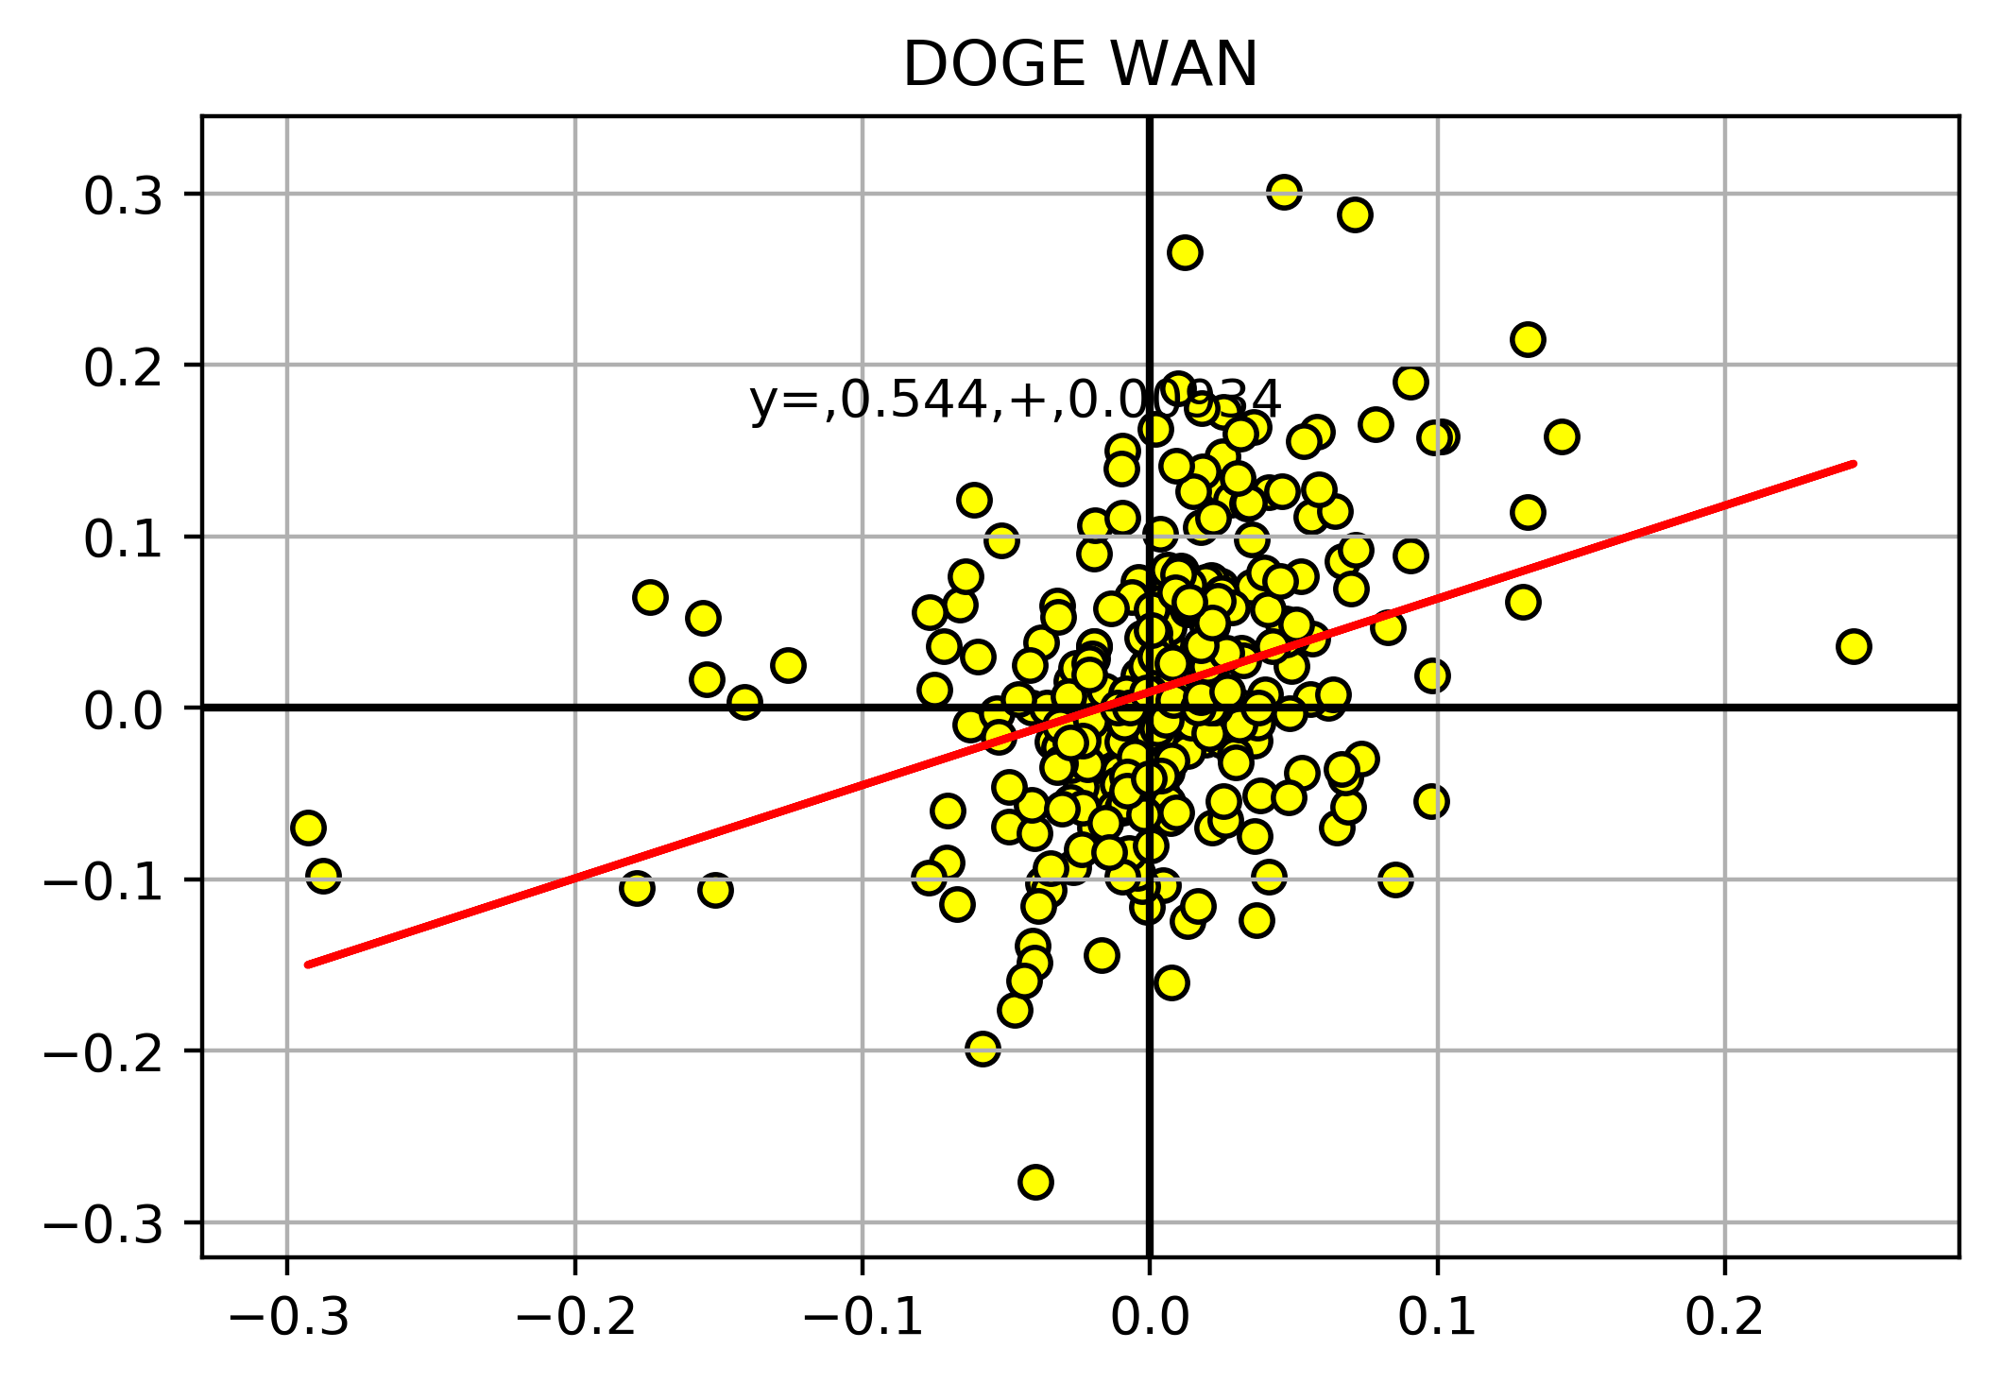
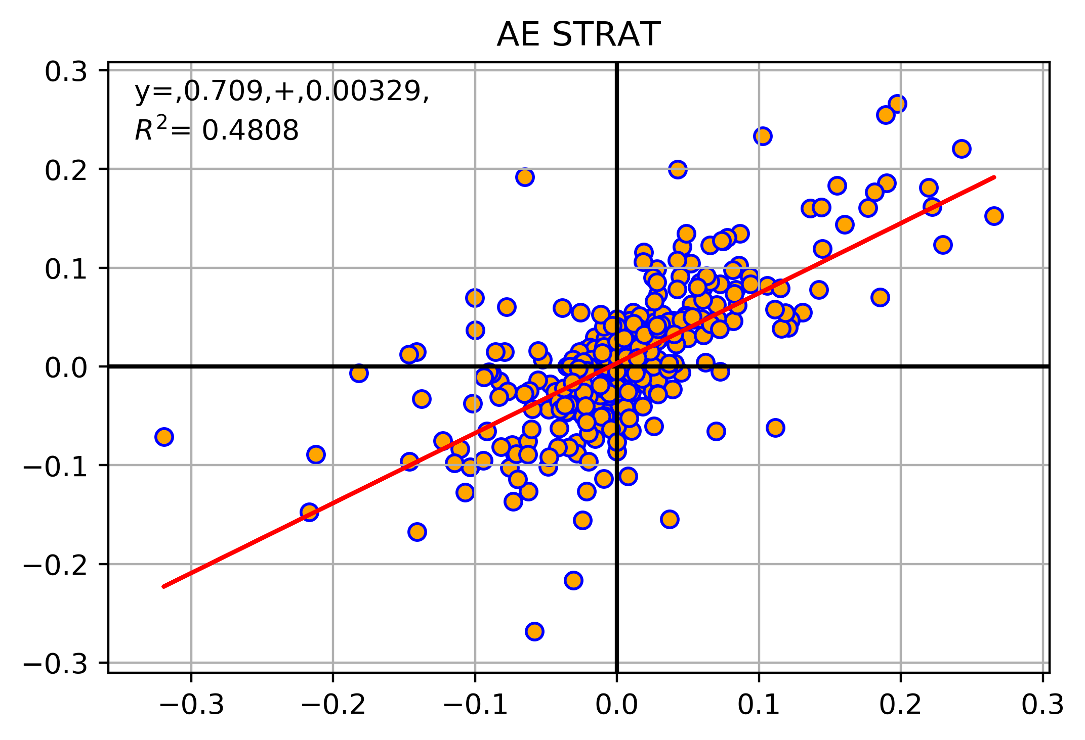
Scatterplot: 1st , 2nd and 3rd Quartile
One 2nd quartile crypto and one bottom 3 crypto: DOGE and Wanchain.
Two cryptos in the 2nd Quartile: Aeternity and Stratis.

Slide 10
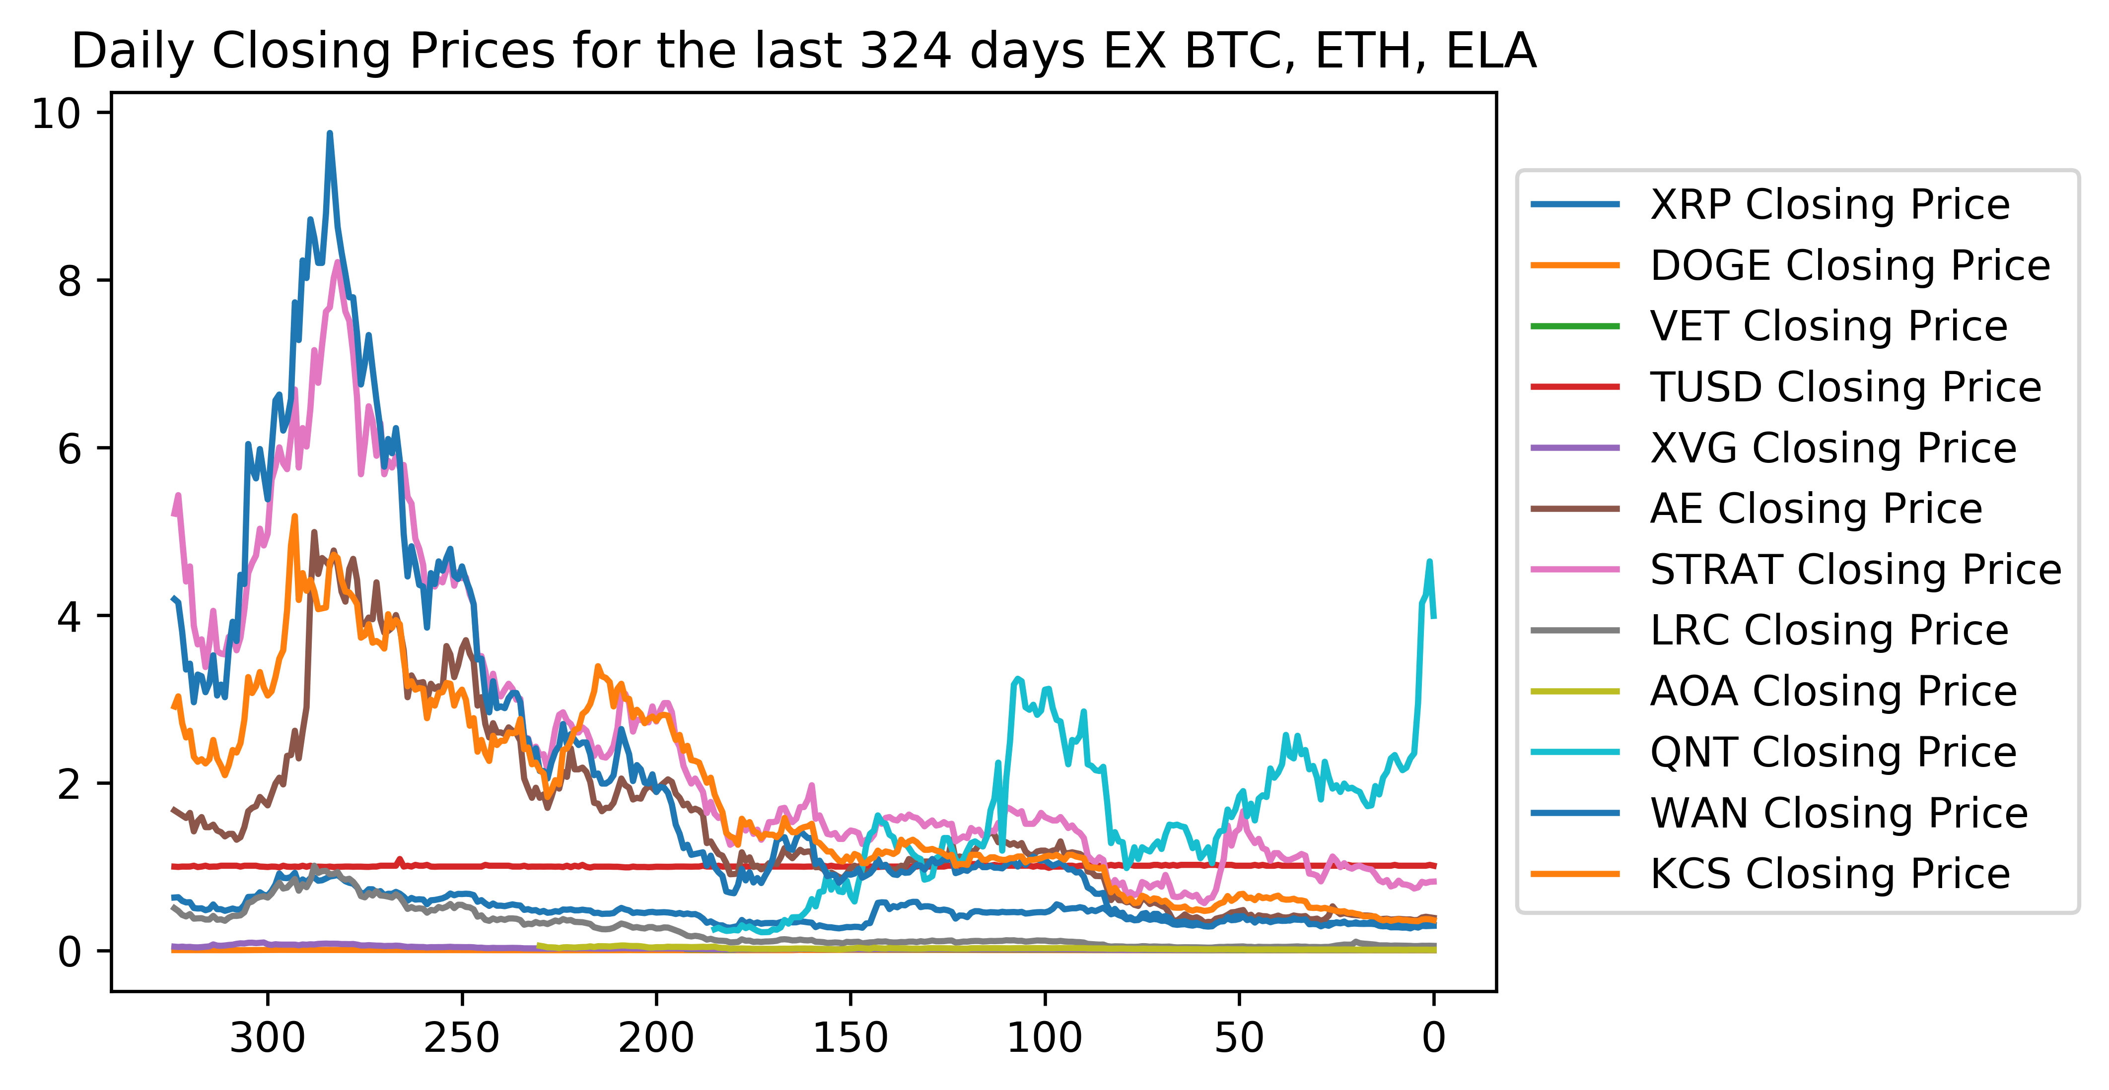
Daily Closing Prices ex. BTC, ETH, ELA

Slide 11
Actionable Results and What’s Next:
Expand data to all cryptocurrencies in the top 100
  Determine new correlating subgroups
  Find commonalities of those subgroups other than market cap and popularity in the market place.
  Calculate or perform other statistical tests for regression lines or correlation
Further understand the fundamental economics drives of each crypto currency, it’s function within the blockchain, and adoptability by the broader market (potential users of the tokens).
With our correlated cryptocurrencies, identify and explore different statistical arbitrages, hedging strategies and portfolio compositions based on a targeted ROI and risk appetite.
Explore and measure the relationship between the cryptocurrency market and other asset classes.
Explore the effect of certain events, announcements and tweets on a basket of highly correlated cryptocurrencies and what kind of events impacts market prices.
Notes:
Scrape all the cryptocurrencies in the top 100 and do a similar analysis, see if there are other correlating subgroups and what are the commonalities of those subgroups other than market cap and popularity in the market place.
Better understand the fundamental economics driving each specific crypto currency, it’s application and function within the blockchain, and its potential adoptability by the broader market (potential users of the tokens).
With our correlated cryptocurrencies we can identify and explore different statistical arbitrages, hedging strategies and portfolio compositions based on a targeted ROI and risk appetite.
We could explore and measure the relationship between the cryptocurrency market and other asset classes and indices.
Can also explore the effect of certain events, announcements and tweets on a basket of highly correlated cryptocurrencies, to ascertain if and what kind of events tend to have an impact on market prices.
Determine what is driving the momentum behind the cryptos.
Add R² values for the regression lines.
Automating code so that it is not done in steps, but rather one smooth process

